Slide 1
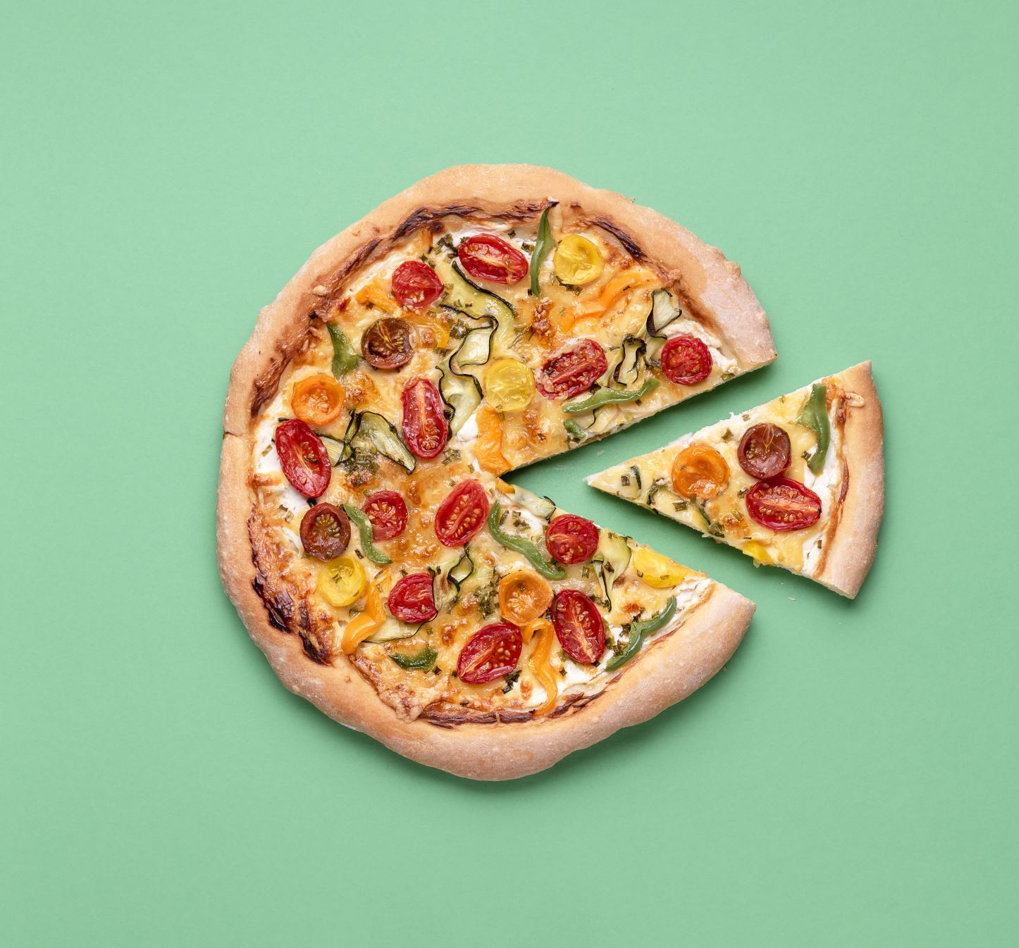
Dominos - Predictive Purchase Order System - Submitted By SURESH KUMAR R

Slide 2
Problem Statement
Dominos needs to optimize its ingredient ordering process by accurately predicting future sales to minimize waste and prevent stockouts.
PROJECT SUMMERY
To avoid ingredient expiration, we forecast pizza sales for the upcoming week. Based on these forecasts, we determine the required quantity of each ingredient and create a purchase order accordingly. This ensures that we only buy the necessary amount of ingredients, minimizing waste and maintaining freshness.

Slide 3
Data cleaning
Identify the missing values then filing the total price calculated form unit price multiple quantity.
The pizza name id, pizza name, pizza ingredient are having missing values. So, I filling missing value based on the existing data.
If you filling missing values some dataset doesn’t have the existing data so that kind of situation can use interpolation, forward and backward filling, mode interpolation and etc.. This kind of filling method use based on your dataset.
Then change the data type on order date column. The order date column having date are different format so, I define the whole format then easy to identify the correct date then change the data type.
The outliers are affecting the forecast, so I remove the outliers and so use capping method because when I remove the outlier the to much of data is gone that’s why I am using capping method. The capping method is basically filling the data upper bond filling upper bond values and lower bond filling lower bond values finally I go on the feature engineering.

Slide 4
Feature engineering & analyzing
Feature engineering plays a crucial role in extracting valuable insights, and highly correlated features often hold significant importance in predictive models.
I can create features for the day of the week, day name, month, year, and week based on the order date. I will also account for us holidays in 2015 and add promotions for Saturdays and Sundays. these features will help extract more insights from my dataset.
The data provided clear and meaningful insights. To facilitate analysis, we should examine the following aspects: daily sales, the top 10 selling pizzas, sales during holidays, sales trends over time, monthly sales figures, comparisons between weekday and weekend sales, sales by pizza category, and sales by pizza size. These analyses will help in making informed decisions.

Slide 5
Model development
The weekly pizza forecasts are generated using ARIMA, SARIMA, and PROPHET models, with MAPE error results presented in the table.
The ARIMA model exhibits a lower MAPE error compared to other models. Therefore, I chose the ARIMA model, and the hyperparameter tuning resulted in the best MAPE of 0.1979.
Finally, save the model as a pickle file and forecast the quantity of pizza ingredients for the next week. I have attached the predicted ingredient quantity CSV file to my GitHub.
MODEL NAME | MAPE
ARIMA | 0.2027
SARIMA | 0.2282
PROPHET | 0.2257

Slide 6
Thank you

